Slide 1
OS Lab Managing Linux Software, Users & Groups and Ownership and Permissions.
Week 3

Slide 2
01
Managing Linux Software
Updating, Upgrading and Installing Softwares

Slide 3
Managing Linux Software
If we spend any time in the Linux community, we hear many opinions as to which of the many Linux distributions is “best.” Often, these discussions get really silly, focusing on such things as the prettiness of the desktop background (some people won't use Ubuntu because of its default color scheme!) and other trivial matters.
Package management is a method of installing and maintaining software on the system. Today, most people can satisfy all of their software needs by installing packages from their Linux distributor. This contrasts with the early days of Linux, when one had to download and compile source code to install software. There isn’t anything wrong with compiling source code; in fact, having access to source code is the great wonder of Linux. It gives us (and everybody else) the ability to examine and improve the system. It's just that having a precompiled package is faster and easier to deal with.
Packaging Systems
Different distributions use different packaging systems, and as a general rule, a package intended for one distribution is usually not compatible with another distribution.
Most distributions fall into one of two camps of packaging technologies: the Debian .deb camp and the Red Hat .rpm camp.
There are some important exceptions such as Gentoo, Slackware, and Arch (pacman).

Slide 4
Managing Linux Software
Package Files
The basic unit of software in a packaging system is the package file. A package file is a compressed collection of files that comprise the software package. A package may consist of numerous programs and data files that support the programs. In addition to the files to be installed, the package file also includes metadata about the package, such as a text description of the package and its contents.
Repositories
While some software projects choose to perform their own packaging and distribution, most packages today are created by the distribution vendors and interested third parties. Packages are made available to the users of a distribution in central repositories that may contain many thousands of packages, each specially built and maintained for the distribution.
Dependencies
Programs are seldom “standalone”; rather they rely on the presence of other software components to get their work done. Common activities, such as input/output for example, are handled by routines shared by many programs. These routines are stored in what are called shared libraries, which provide essential services to more than one program. If a package requires a shared resource such as a shared library, it is said to have a dependency. Modern package management systems all provide some method of dependency resolution to ensure that when a package is installed, all of its dependencies are installed, too.

Slide 5
Managing Linux Software
High and Low-level Package Tools
Package management systems usually consist of two types of tools:
Low-level tools which handle tasks such as installing and removing package files
High-level tools that perform metadata searching and dependency resolution
Distributions | Low-Level Tools | High-Level Tools
Debian style | dpkg | apt, apt-get, aptitude
Fedora, Red Hat Enterprise Linux, CentOS | rpm | yum, dnf
Notes:
Apt vs apt-get https://itsfoss.com/apt-vs-apt-get-difference/
Exercise (page 199): search, download, remove, install using .deb, upgrade, listing
To-Do: Ask them how to list all of the files installed using apt
El low level benazel el file el high level benazel el metadata m3 el depandancies

Slide 6
Command: dpkg
dpkg is a package manager for Debian, Ubuntu and many other Linux distro. It is used to install/manage individual packages.
Syntax:
dpkg [options] [package]
Different functionalities of useradd command :
Install the package: dpkg -i [.deb package]
Upgrade package if it is installed else install a fresh copy of package: dpkg -i [.deb package]
List all installed packages, along with package version and short description : dpkg -l
Remove/Delete an installed package except configuration files: dpkg -r [package]
Remove/Delete everything including configuration files: dpkg -P [package]

Slide 7
Command: apt
apt provides a high-level CLI (Command Line Interface) for the package management system.
Syntax:
apt [options] [package]
Different functionalities of useradd command :
Update package information from all configured sources: apt update
Install available upgrades of all packages currently installed on the system: apt upgrade
Install a new package : apt install <package_name>
Remove a package : apt remove <package_name>
Remove/Delete everything including configuration files: apt purge <package_name>

Slide 8
Questions?

Slide 9
02
Managing Linux Users and Groups
Managing a multi-user operating system.

Slide 10
Managing Linux Users and Groups
Linux is a multiuser system, so it has many user accounts. Even if you’ve set up a test machine and you’re the only user using that system, you’ll have a host of system user accounts. Most of these accounts aren’t for people to use; they’re for running specific programs, because many servers require a unique username and group name. The FTP server, for example, runs under the username ftp.
User accounts can belong to one or more groups. Typically, each username has a corresponding private group name. By default, each user belongs to that corresponding private group, but you can define other groups for the purpose of providing access to specific files and directories based on group membership.
User and group ownerships of files ensure that only the right people (or the right processes) can access certain files and directories. Managing the user and group accounts is a typical task in system administration. It’s not hard to do this part of the job, given the tools that come with Linux, as you discover in this chapter.

Slide 11
Important files
/etc/passwd
/etc/shadow
/etc/group
contains the attributes of each user or account the system. The permissions for /etc/passwd are by default set so that it is world readable, that is, so that it can be read by any user on the system
contains encrypted password as well as other information such as account or password expiration values, etc. The /etc/shadow file is readable only by the root account
defines the groups to which users belong to, which allows additional abilities to be delegated in an organized fashion, such as access to disks, printers, and other peripherals, as well as delegating some administrative tasks to normal users.

Slide 12
Command: useradd
useradd is a command used to create a new user or update default new user information
Syntax:
useradd [options]
Different functionalities of useradd command :
Create a new user on the system: useradd username
Create user and with home directory: sudo useradd -m username
Create new user then add the user to the specified group: useradd -G newGroup
Create a user with a short description about it (usually used for the full name : useradd -c Example

Slide 13
Command: passwd
passwd command in Linux is used to change the user account passwords. The root user reserves the privilege to change the password for any user on the system, while a normal user can only change the account password for his or her own account.
Syntax:
passwd [options] [username]
Different functionalities of passwd command :
Change logged in user password: passwd
Change other user’s password: sudo passwd user_name
Change root password: sudo passwd root

Slide 14
Command: usermod
usermod is a command used to modify existing users on the system.
Syntax:
usermod [options] [username]
Different functionalities of usermod command :
Add user to existing group: usermod -a -G administrators user
Lock the user’s password, preventing it from being used for login: usermod -L user
Unlock the user’s password if locked with -L : usermod -U user

Slide 15
Command: userdel
userdel is a command used to delete a user account and related files.
Syntax:
userdel [options] [username]
Different functionalities of userdel command :
Delete a user from the system: userdel user
Delete a user account from the system and remove the user’s home directory: userdel -r user
Force delete a user account even in the account is logged in, implies -f : userdel -f user

Slide 16
Command: su
su is a command used to switch to another user.
Syntax:
su [options] [username]
Different functionalities of userdel command :
Switch to another user: su user
Switch to another user with the new user default login environment: su - user
Switch to root user : su

Slide 17
Commands: groupadd & groupdel
groupadd is a command used to create new groups on the system.
Syntax:
groupadd [options] [group name]
Different functionalities of groupadd command :
Add a new group to the system: groupadd newGroup
groupdel is a command used to delete groups on the system.
Syntax:
groupdel [group name]
Different functionalities of groupdel command :
Delete a group from the system: groupdel newGroup

Slide 18
Questions?

Slide 19
03
Managing Ownership and Permissions
Who can do what exactly?

Slide 20
Managing Ownership and Permissions
Operating systems in the Unix tradition differ from those in the MS-DOS tradition in that they are not only multitasking systems, but also multi-user systems.
What exactly does this mean? It means that more than one person can be using the computer at the same time. While a typical computer will likely have only one keyboard and monitor, it can still be used by more than one user. For example, if a computer is attached to a network or the Internet, remote users can login via ssh (secure shell) and operate the computer.
The multi-user capability of Linux is not a recent "innovation," but rather a feature that is deeply embedded into the design of the operating system. Considering the environment in which Unix was created, this makes perfect sense.
Years ago, before computers were "personal," they were large, expensive, and centralized. A typical university computer system, for example, consisted of a large central computer located in one building and terminals that were located throughout the campus, each connected to the large central computer. The computer would support many users at the same time. To make this practical, a method had to be devised to protect the users from each other. After all, the actions of one user could not be allowed to crash the computer, nor could one user interfere with the files belonging to another user.

Slide 21
Owners, Group Members, and Everybody Else
In the Unix security model, a user may own files and directories. When a user owns a file or directory, the user has control over its access. Users can, in turn, belong to a group consisting of one or more users who are given access to files and directories by their owners. In addition to granting access to a group, an owner may also grant some set of access rights to everybody, which in Unix terms is referred to as the world.
When user accounts are created, users are assigned a number called a user ID (uid) which is then, for the sake of the humans, mapped to a username. The user is assigned a primary group ID (gid) and may belong to additional groups.
User accounts are defined in the /etc/passwd file and groups are defined in the /etc/group file. When user accounts and groups are created, these files are modified along with /etc/shadow which holds information about the user's password. For each user account, the /etc/passwd file defines the user (login) name, uid, gid, account's real name, home directory, and login shell. If we examine the contents of /etc/passwd and /etc/group, we notice that besides the regular user accounts, there are accounts for the superuser (uid 0) and various other system users.
While many Unix-like systems assign regular users to a common group such as “users”, modern Linux practice is to create a unique, single-member group with the same name as the user. This makes certain types of permission assignment easier.

Slide 22
Reading, Writing, and Executing
Access rights to files and directories are defined in terms of read access, write access, and execution access.
If we look at the output of the ls command, we can get some clue as to how this is implemented:
root@lwd:/tmp# ls -l file1.txt -rw-r--r-- 1 root root 0 Oct 13 22:41 file1.txt
The first 10 characters of the listing are the file attributes. The first of these characters is the file type (File, Directory, Symbolic Link, Character Special file or block special file)
The remaining nine characters of the file attributes, called the file mode, represent the read, write, and execute permissions for the file's owner, the file's group owner, and everybody else.
Owner | Group | Others
rwx | rwx | rwx

Slide 23
Reading, Writing, and Executing
Attribute | Files | Directories
r | Allows a file to be opened and read. | Allows a directory's contents to be listed if the execute attribute is also set.
w | Allows a file to be written to or truncated, however this attribute does not allow files to be renamed or deleted. The ability to delete or rename files is determined by directory attributes. | Allows files within a directory to be created, deleted, and renamed if the execute attribute is also set.
x | Allows a file to be treated as a program and executed. | Allows a directory to be entered, e.g., cd directory.
Notes:
Octal table: https://www.adminschoice.com/chmod-quick-referance-with-examples

Slide 24
Command: chmod
In Unix-like operating systems, the chmod command is used to change the access mode of a file.
The name is an abbreviation of change mode.
Syntax:
chmod [reference][operator][mode] file...
Different functionalities of chmod command :
Let’s change the file.txt permission so that the owner cannot write(w) in the file but can only read it: chmod u=r file.txt
Let’s restrict the permission such that the user cannot search the directory CLASS: chmod u=rw CLASS
Let’s change the file.txt permission so that the owner can execute it: chmod u+x file.txt
Let’s give owner full permissions on file.txt will limiting the group and others to read only: chmod 744 file.txt

Slide 25
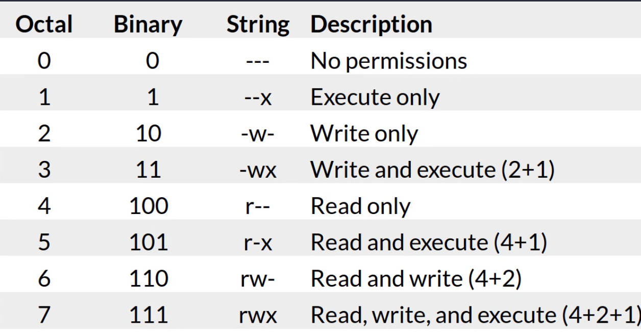
Command: chmod

Slide 26
Command: chown
chown command is used to change the file Owner or group. Whenever you want to change ownership you can use chown command.
Syntax:
chown [OPTION]… [OWNER][:[GROUP]] FILE…
Different functionalities of chown command :
To change owner of the file: chown owner_name file_name
To Change group ownership: chown :group_name file_name
To change the owner as well as group: chown owner_name:group_name file_name
To copy ownership of one file to another: chown --reference=file_name_1 file_name_2

Slide 27
Questions?

